Slide 1
Cardiovascular Disease Prediction
ACM40960-Projects in Maths Modelling
Presented By: Vinit Dhande (20202078)
Course: MSc Data & Computational Science

Slide 2
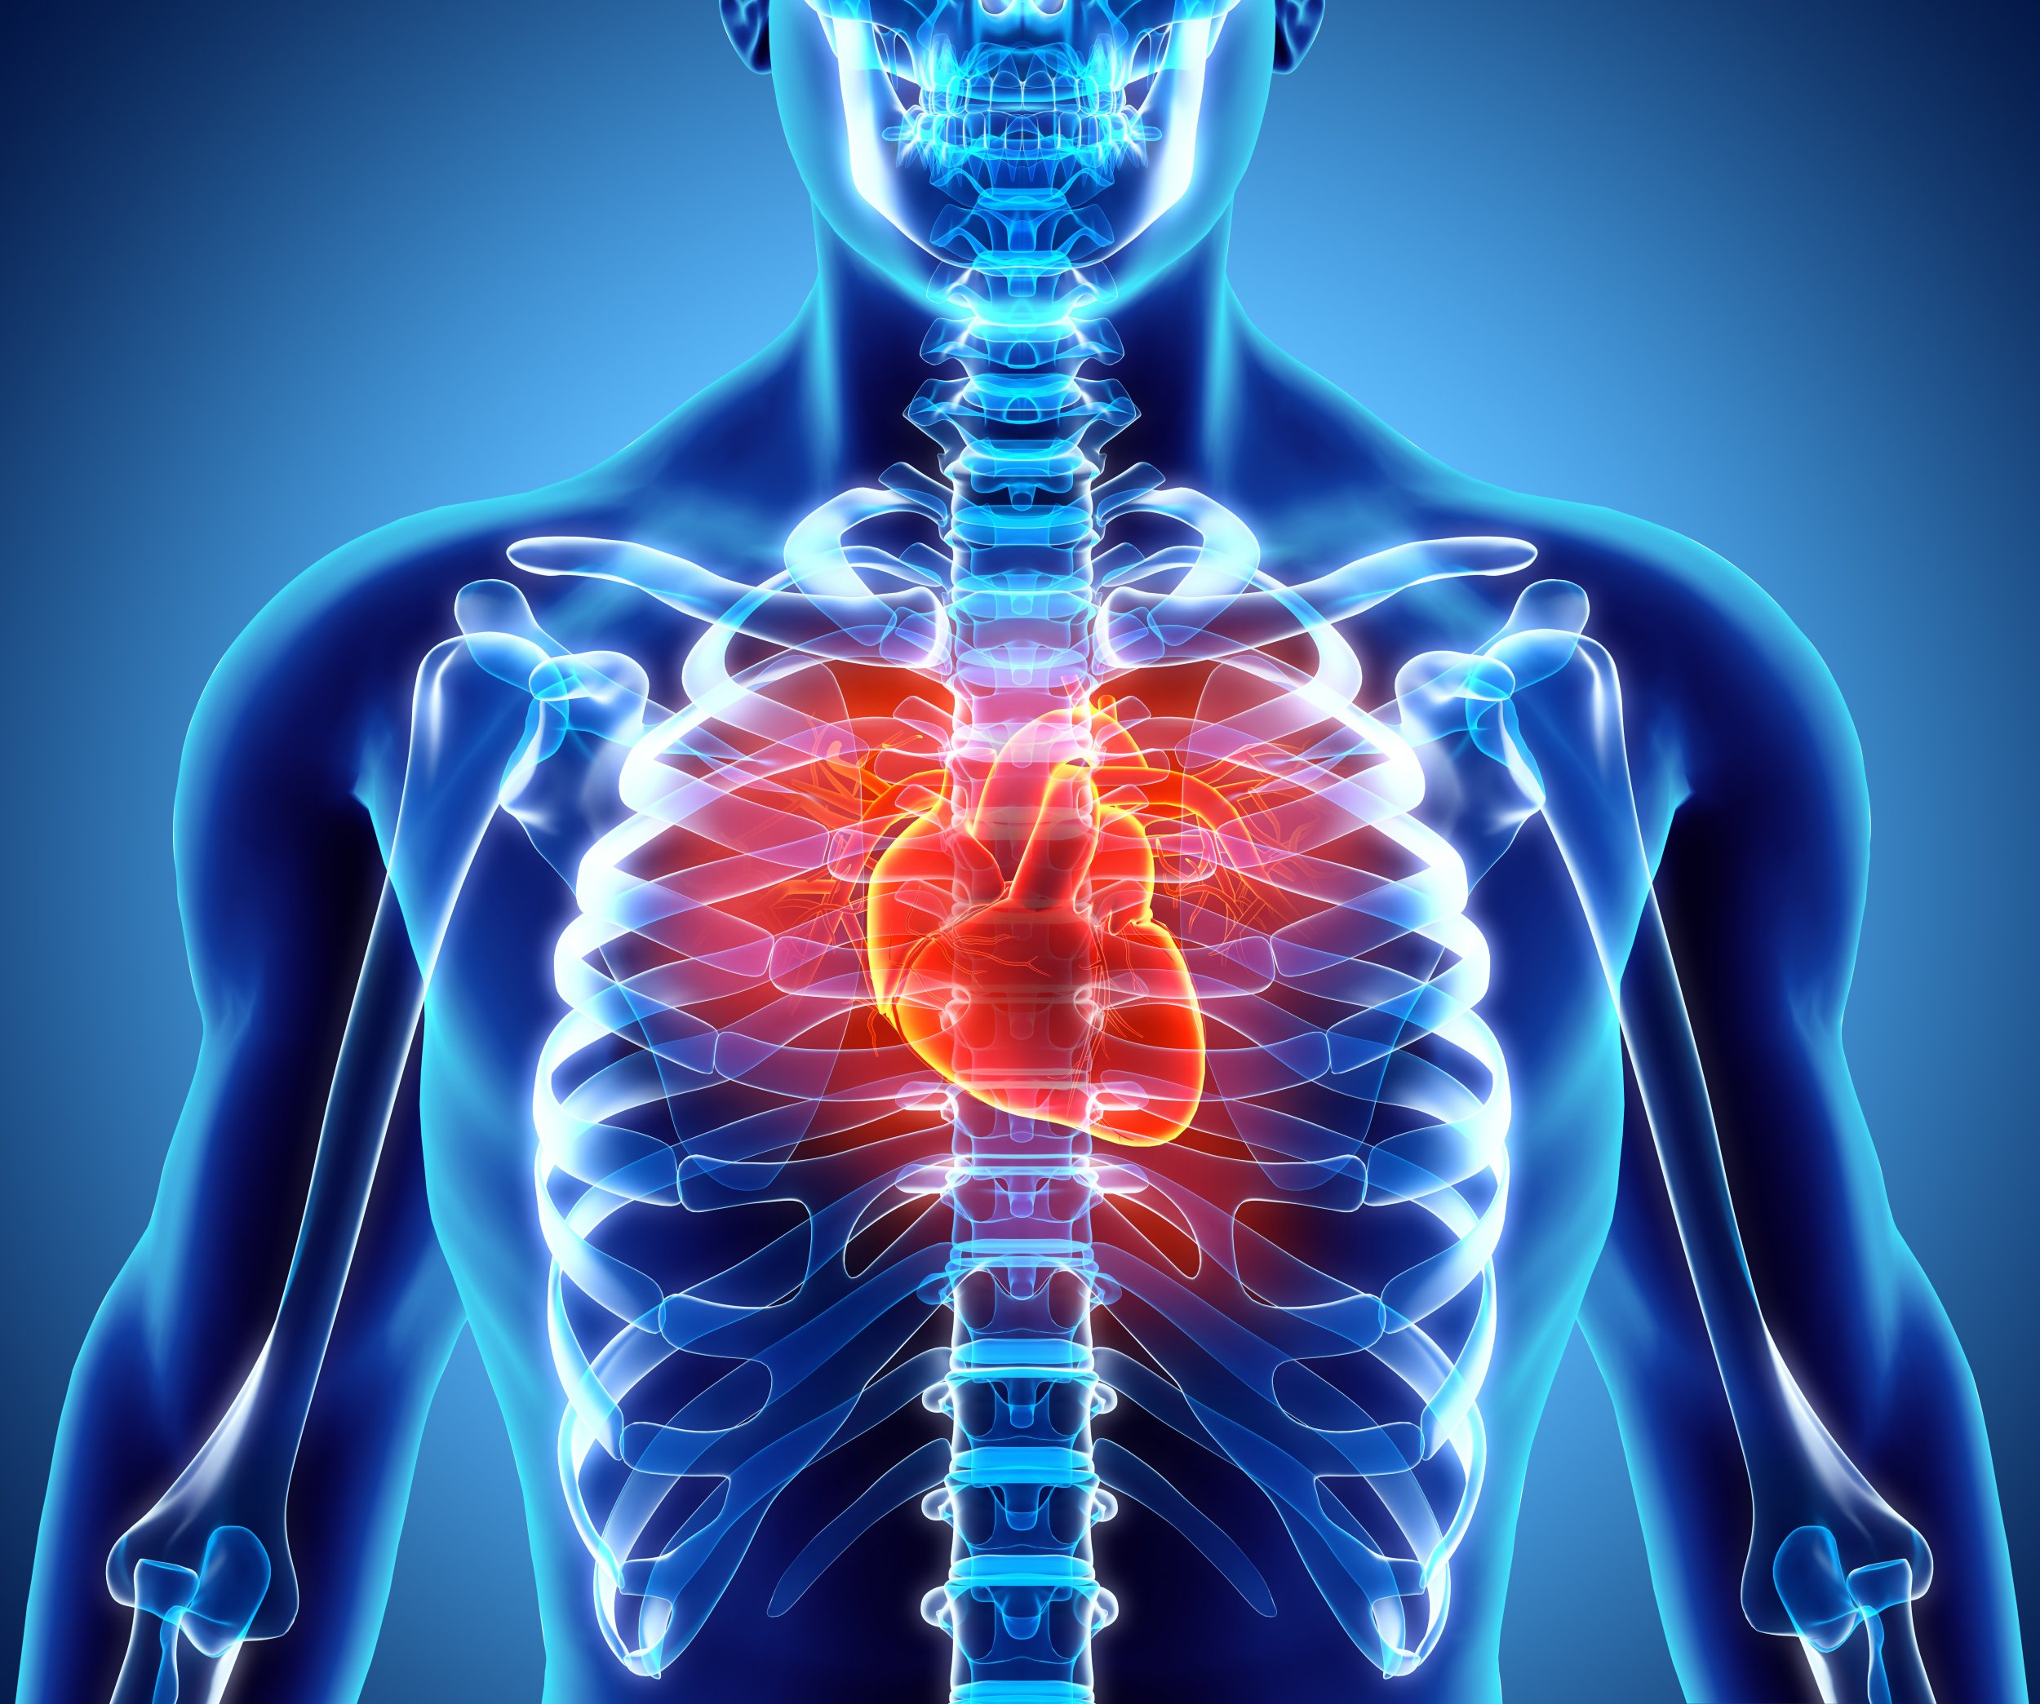
Abstract
Cardiovascular diseases are a group of disorders of the heart and blood vessels
More people die annually from CVDs than from any other cause
Most patients are diagosed after first heart attack or stroke
Need early detection and management using counselling and medicines
Risk reduction using the data-driven techniques

Slide 3
Objectives
Derive the patterns in the data for the patients with CVD
Describe which factors may indicate vascular risk.
Identify who to screen for cardiovascular risk assessment

Slide 4
Dataset
Objective
Age, Height, Weight, Gender
Examination
Systolic and Diastolic blood pressure, Cholesterol, Glucose
Subjective
Smoking, Alcohol intake, Physical activity
Target
Presence or absence of cardiovascular disease

Slide 5
Methodology(Python)
Data processing and cleaning
Data exploration and visualization
Data mining
Building model
Performance evaluation and optimization
Validating the results

Slide 6
Thank You!

